Slide 1
Module 5
Creating Tidy Data

Slide 2
Contents
Gathering -- gather()
Spreading -- spread()
Separating – separate()
Uniting -- unite()

Slide 3
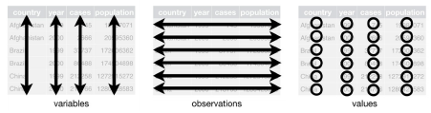
Creating Tidy Data
Data tidying is a consistent way of organizing data in R and can be facilitated through the tidyr package found in the tidyverse ecosystem.
Tidy datasets provide a standardized way to link the structure of a dataset (its physical layout) with its semantics (its meaning)
Three rules that we can follow to make a dataset tidy.
First, each variable must have its own column.
Second, each observation must have its own row
Finally, each value must have its own cell.

Slide 4
Advantages of Tidy Data
The general advantage of Tidy data is having one consistent, uniform way of storing data. If you have a consistent data structure, it’s easier to learn the tools that work with it because they have an underlying uniformity.
The specific advantage is to place variables in columns because it allows for easy facilitation of vectorization in R (i.e, R’s vectorised nature will be shine). As you learned in dplyr, ggplot, mutate, summary functions, most built-in R functions work with vectors of values. That makes transforming tidy data feel particularly natural.

Slide 5
Few Reasons why dataset isn’t Tidy?
Oftentimes the people who created the dataset aren’t familiar with the principles of tidy data.
Another common reason that datasets aren’t tidy is that data is often organized to facilitate something other than analysis.
To make data entry as easy as possible, people will often arrange data in ways that aren’t tidy.

Slide 6
Tidying messy dataset
Five most common problems with messy datasets along with their remedies:
Column headers are values, not variable names.
Multiple variables are stored in one column.
Variables are stored in both rows and columns.
Multiple types of observational units are stored in the same table.
A single observational unit is stored in multiple tables.
The first step is to figure out what the variables and observations are for the dataset. This will facilitate your understanding of what the columns and rows should be.
In addition, you will also need to resolve common problems, like figure out if one variable is spread across multiple columns, and also figure out if one observation is scattered across multiple rows.

Slide 7
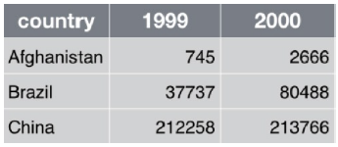
Gathering
Consider the common problem in many datasets that the column names are not variables but rather values of a variable.
In the figure below, the 1999 and 2000 columns are actually values of the variable YEAR. Each row in the existing table actually represents two observations.
The tidyr package can be used to gather these existing columns into a new variable. In this case, we need to create a new column called YEAR and then gather the existing values in the 1999 and 2000 columns into the new YEAR column.

Slide 8
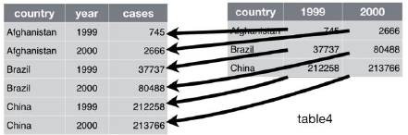
Gathering – gather() function
The gather() function from the tidyr package can be used to accomplish the gathering of data.
There are three parameters of the gather() function.
The first is the set of columns that represent what should be values and not variables. Ex: 1999 and 2000 columns
Next, you’ll need to name the variable of the new column. This is also called the key, and in this case will the year variable.
Finally, you’ll need to provide the value, which is the name of the variable whose values are spread over the cells.
gather('1999', '2000', key = 'year', value = 'cases')

Slide 9
Exercise 1: Gathering
1. Make sure the working directory is set, readr and tidyr packages are loaded.
2. Load the CountryPopulation.csv file
dfPop = read_csv("CountryPopulation.csv", col_names = TRUE)
3. If needed Use the View() function to display the data in a tabular structure.
View(dfPop)
4. Use the gather() function
dfPop2 = gather(dfPop, `2010`, `2011`, `2012`, `2013`, `2014`, `2015`, `2016`,`2017`, key = 'YEAR', value = 'POPULATION')
5. View the output.
View(dfPop2)

Slide 10
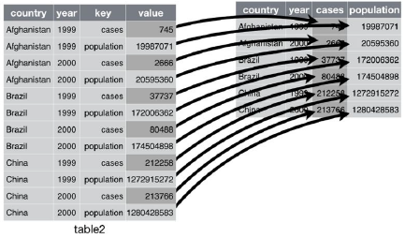
Spreading
Spreading is the opposite of gathering and is used when an observation is spread across multiple rows.
Consider an observation of one country per year. However, you’ll notice that this is spread across two rows. One row for cases and another for population.

Slide 11
Spreading – spread() function
The spread() function takes two parameters:
the column that contains variable names, known as the key
a column that contains values from multiple variables – the value
Exercise 2:
1. For this exercise you’ll download some sample data that needs to be spread.
Install the devtools package and DSR datasets using the code you see below by typing in the Console pane. Alternatively, you can use the Packages pane to install the packages.
install.packages("devtools")
devtools::install_github("garrettgman/DSR")

Slide 12
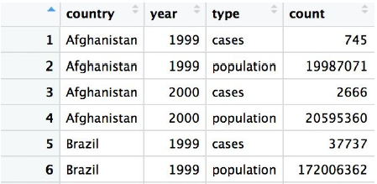
Exercise 2 (cont…)
2. Load the DSR library by going to Package and clicking the check box
next to DSR.
3. View table2. In this case, an observation is one country per year, but
you’ll notice that each observation is actually spread into two rows.
View(table2)

Slide 13
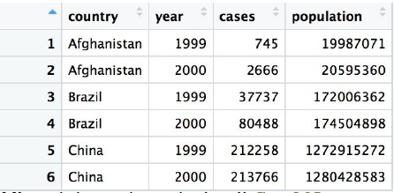
Exercise 2 (cont…)
4. Use the spread() function to correct this problem.
table2b = spread(table2, key = type, value = count)
5. View the results.
View(table2b)

Slide 14

Separating
Lets us consider another common case involves two variables being placed into the same column.
For Example:
State-Country Name column actually contains two variables separated by a slash.
separate() function
The separate() function can be used to split a column into multiple columns by splitting on a separator.
By default, the separate() function will automatically look for any nonalphanumeric character or you can define a specific character.
Here, the separate() function will split the values of the State-County Name column into two variables: StateAbbrev and CountyName.

Slide 15


Exercise 3:
Load the usco2005.csv file
df = read_csv("usco2005.csv", col_names = TRUE)
View the imported data.
View(df)
Use the separate() function to separate the contents of the StateCounty Name column into StateAbbrev and CountyName columns.
df2 = separate(df,"State-County Name",into = c("StateAbbrev","CountyName"))
View the results.
View(df2)

Slide 16
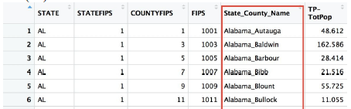
Uniting
The Unite()function is the exact opposite of separate() in that it combines multiple columns into a single column.
Exercise 4: unite() function
Consider below to unite the StateAbbrev and CountyName columns back into a single column.
df3 = unite(df2, State_County_Name, StateAbbrev, CountyName)
View the result.
View(df3)

